Slide 1
Final Project – Scientific Computation and Programming
Susmitha Chereddy
Swetha Lenkala

Slide 2
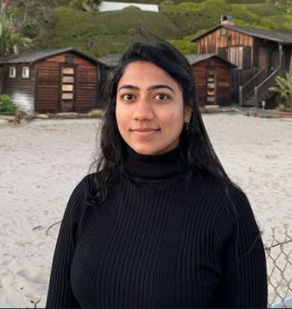
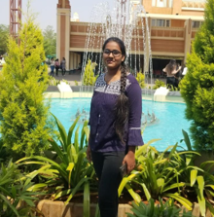
Team
Susmitha Chereddy
Swetha Lenkala

Slide 3


Text Mining and Sentimental Analysis on Trip Advisor Reviews

Slide 4
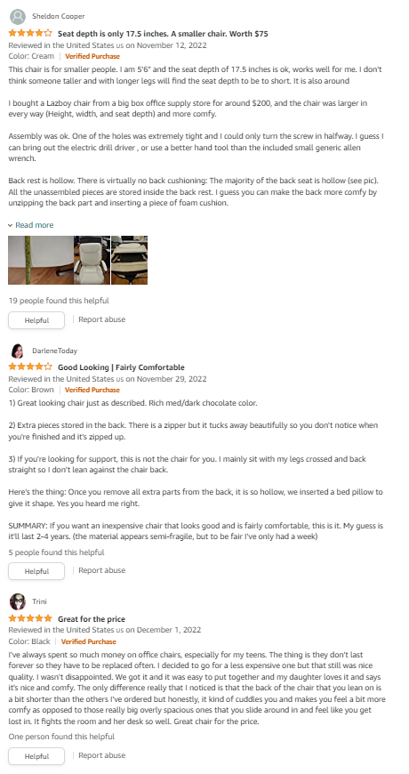
Introduction
Any activity/purchase nowadays is decided based on reviews.
Can you guess the sentiment of this review?
[1] "Stayed here for 5 nights 5/12/16 - 5/17/16. The first night we noticed one of the floor tiles broke and kids were playing with their fingers. The second night we start seeing small cock roaches crawling on our baby's food. The front desk offered new room however they request is to move within 1 hour, otherwise they can't let us switch... It was late in the night 11pm, we all tired and babies were already sleep. We decline the offer. When checkout, the front counter lady told me cock roaches are common in this hotel rooms. And asked me California don't have any cock roaches? This is way beyond my expectation for Hilton."
Yes, you are right. This is negative sentiment.
What if there are thousands of these and you must read through all of them??

Slide 5
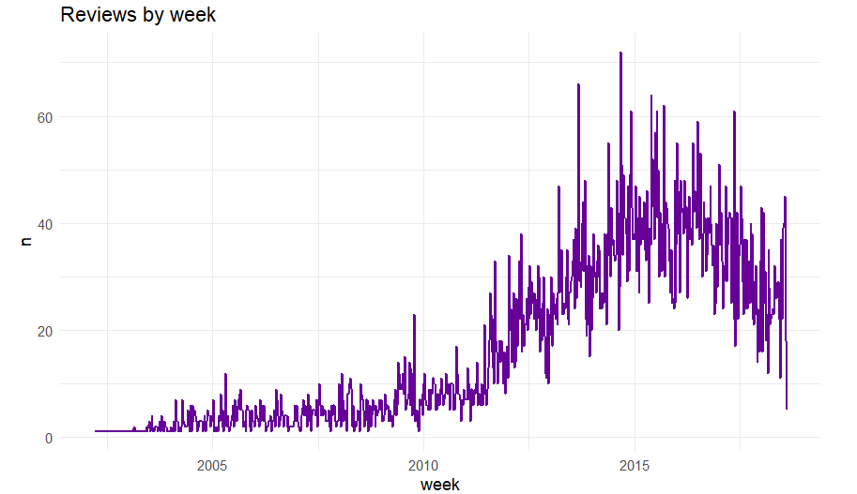
Data
Data from Kaggle on Hilton Hawaiian Village Beach Resort located in Honolulu.
Has 13701 reviews and date when review was left over 21 years.

Slide 6
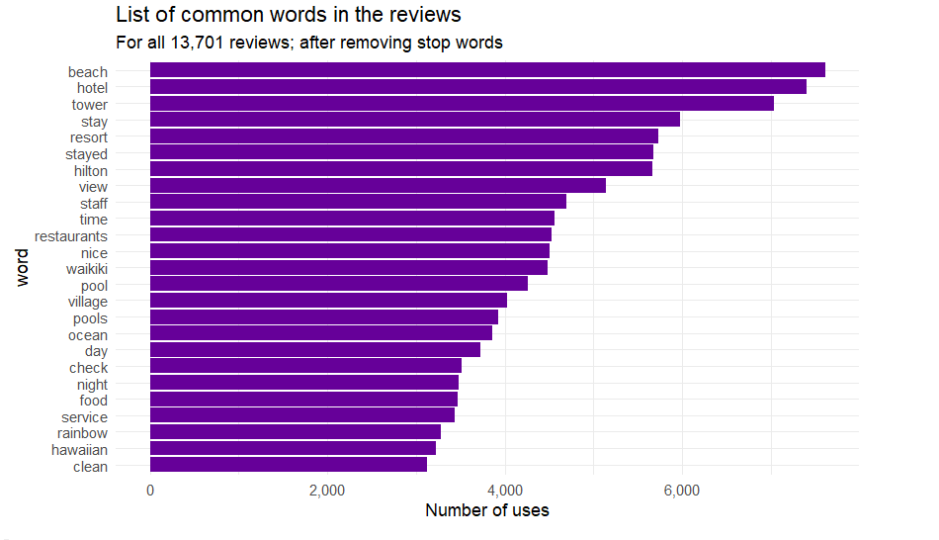
Remove stop words
The below graph shows the distribution of most used words after removing stop words such as is,the,was,in,of,me,you,her,..etc. Full list of stop words can be found at https://countwordsfree.com/stopwords

Slide 7
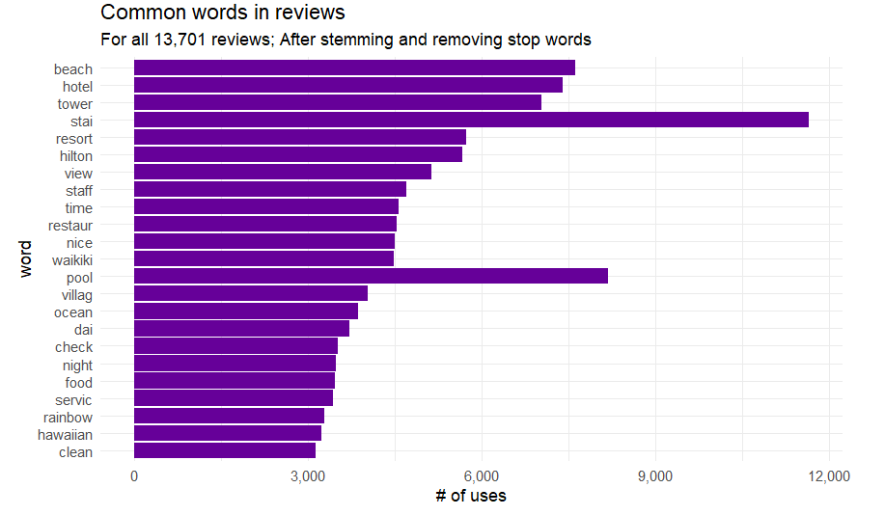
Stemming
Stemming is as below:
{Played, plays, playing} can grouped under the stem “Play”.
From the above graph we see the commonly used words after stemming them. Now both stay and stayed fall under stai by still retaining the meaning/sentiment for the word.

Slide 8
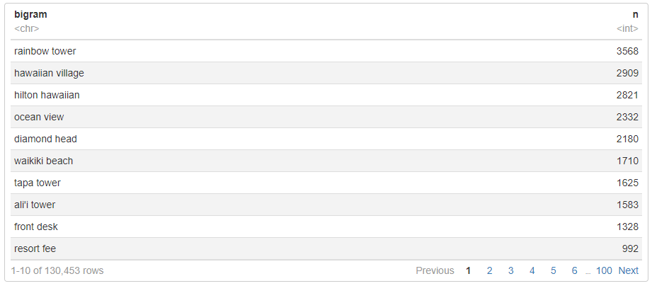
Bigrams
Bigrams are the words that occur together.
Words/meaning of the words often change when they are used together and hence it is essential to study bigrams.

Slide 9
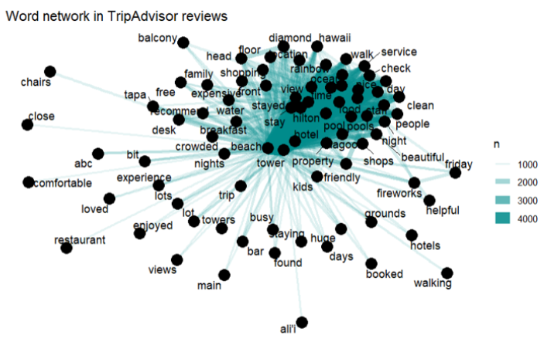
Bigrams

Slide 10
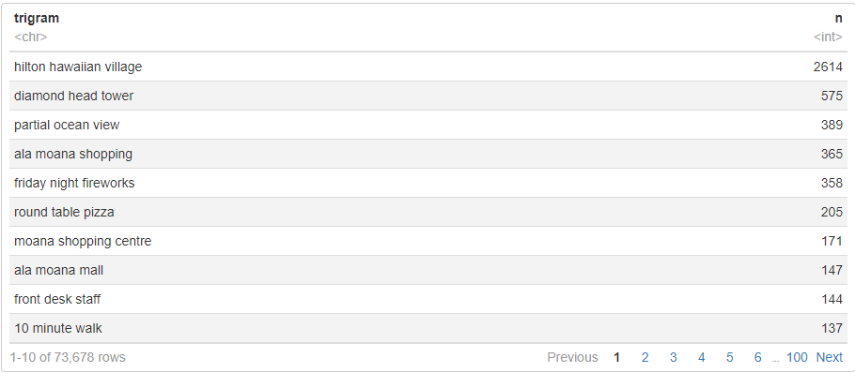
Trigrams
Now, let us look at trigrams to understand the review much better. Trigrams are the list of three words that co-occur together in sentence.

Slide 11
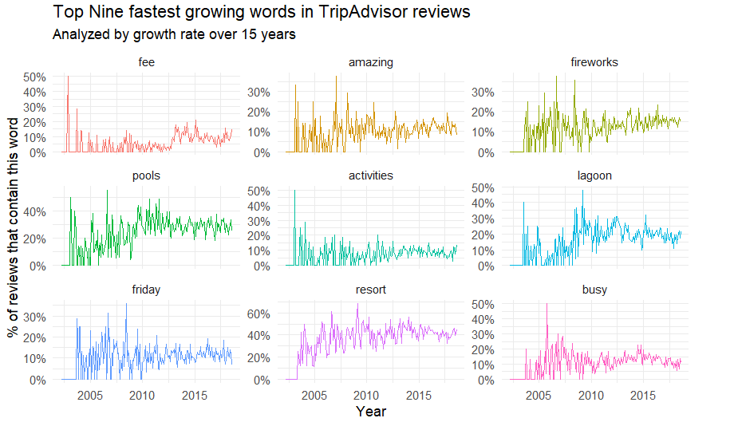
Fastest Growing words

Slide 12
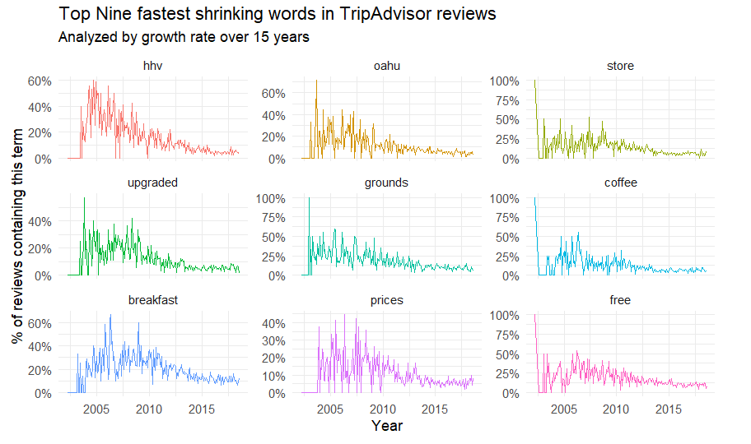
Fastest Shrinking words

Slide 13
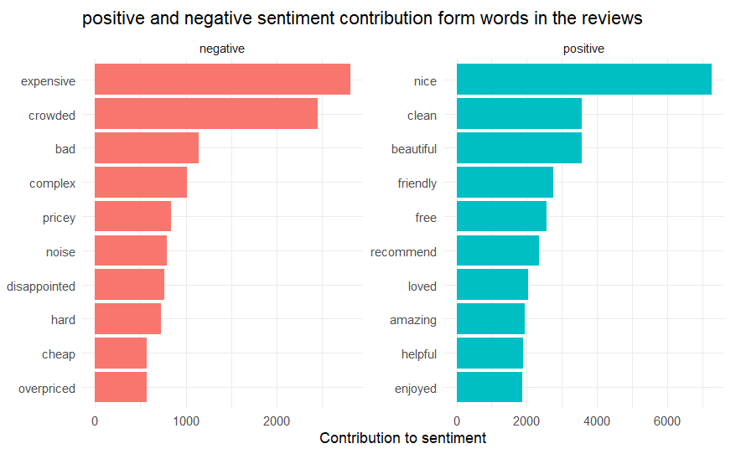
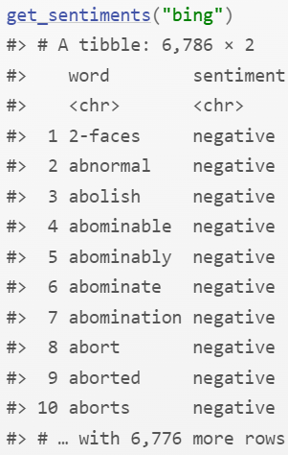
Positive and negative words
The tidytext package provides access to several sentiment lexicons : bing from Bing Liu and collaborators and AFINN from Finn Årup Nielsen.
These lexicons have positive/negative sentiment assigned to all words in English language.
The bing lexicon divides words into two categories: positive and negative.

Slide 14
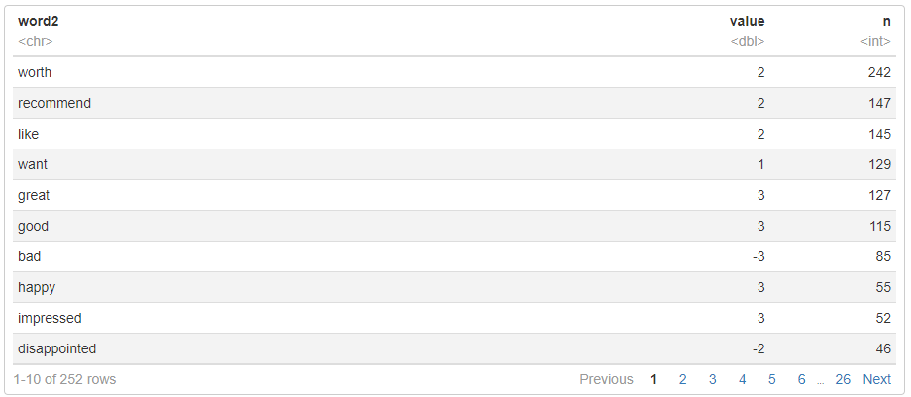
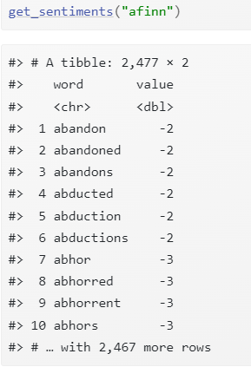
AFFIN for sentiment
Popular lexicon used for sentimental analysis AFINN developed by Finn Arip Neilsen.
This is a repository of 3300+ words with polarity assigned to them to analyze if tend to lean positive / negative.
The AFINN lexicon ranks words from -5 to 5, with negative scores indicating negative sentiment and positive scores indicating positive sentiment.

Slide 15
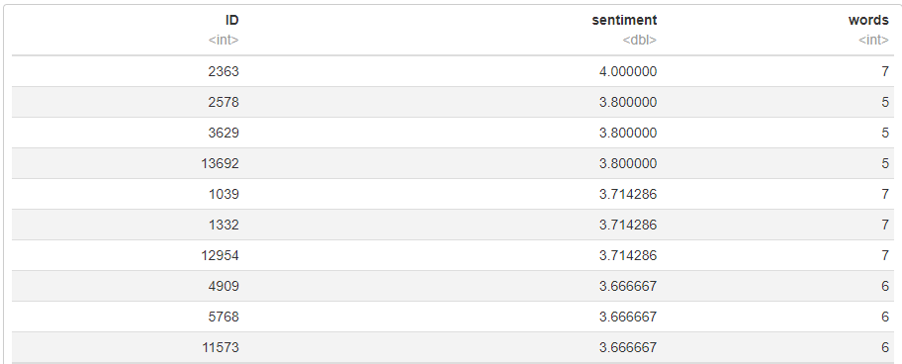
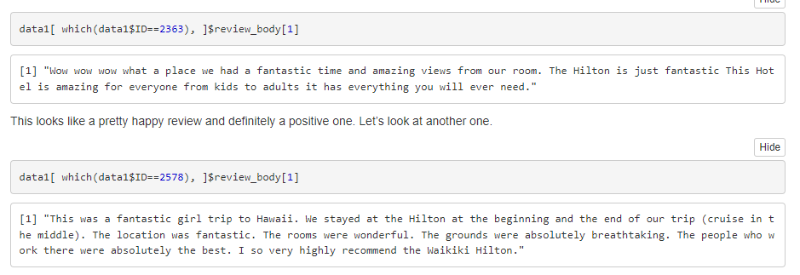
Highest positive sentiment

Slide 16
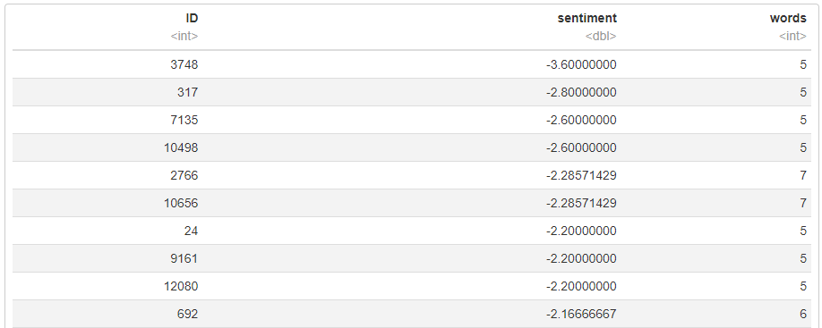
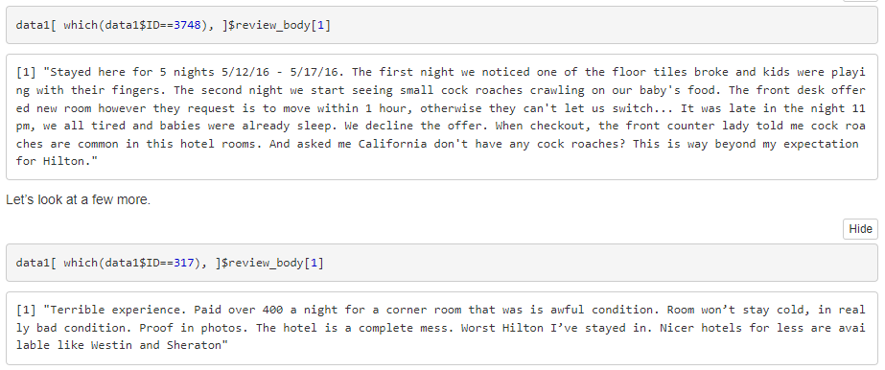
Highest Negative sentiment

Slide 17
Future Extensions
What if the data is in audio format?
Using speech to Text conversion convert audio to text and repeat the same process described for text mining.
What if the data is in video/image format?
Using OpenCV and mediapipe read the video and recognize the gestures.
Sample demo: https://www.youtube.com/watch?v=3Ua-4sb4WbA&ab_channel=SusmithaChereddy

Slide 18

Thank you
Susmitha Chereddy
schereddy2371@floridapoly.edu
Swetha Lenkala
slenkala@4630@floridapoly.edu

